Slide 1
CS3391 Object Oriented Programming
Dr.D.Sivaganesan, Professor, PSGiTech / CSE
Object Oriented Programming Dr.D.Sivaganesan PSGiTech / CSE
1

Slide 2
Making mistakes while developing the program. A mistake might lead to error, causing program to produce unexpected results.
Errors
Errors indicate serious problemsabnormal conditions that most applications not try to handle. Error defines problems that are not expected to be caught under normal circumstances by our program.
Ex: memory error, hardware error, JVM error etc.
Two types of errors
Compile time error
All syntax errors are called as compile time errors
Ex: missing ; , wrong syntax – If etc.,
Run time error
Some times program might be compilercreates . Class file, but
may not run properly due to logic errors.
Ex: divide by zero, accessing array element from wrong location etc.,
Object Oriented Programming
Dr.D.Sivaganesan PSGiTech / CSE
2

Slide 3
Exceptions are conditions, that is caused by run time error in the program.A developer can handle such conditionstake necessary corrective actions.
An exception (or exceptional event) is a problem that arises during the execution of a program.
When an Exception occurs the normal flow of the program is disturbedthe program/Application terminates abnormally, which is not recommended, therefore, these exceptions are to be handled.
If an exception is raised, which has not been handled by programmer then program execution can get terminatedsystem prints a non user friendly error message.
Ex:
Exception in thread "main" java.lang.ArithmeticException: / by zero at ExceptionDemo.main(ExceptionDemo.java:5)
Object Oriented Programming
Dr.D.SivaganesanN.Arvaindhraj PSGiTech / CSE
3

Slide 4
Exceptions Handling
There are two segment blocks are required to handle the exceptions
Try block – to catch the exception by exception object
Catch block – take corrective actions based on exception message thrown by exception object
This process is called exception handling
exception handling - 4 processes
Finding problem(hit the exception)
Inform an error is occur(thrown the exception)
Receive the error information(catch the exception)
Take corrective actions(handle exception)
Object Oriented Programming
Dr.D.Sivaganesan PSGiTech / CSE
4

Slide 5
try – catch block
Syntax :
try
{
// statements that cause exceptions;
}
catch(ExceptionType1 e1)
{
//Catch block- statements that handle exceptions by object
}
Categories of Exceptions
Checked exceptions −A checked exception is an exception that occurs at the compiletime, these are also called as compile time exceptions. These exceptions cannot simply be ignored at the time of compilation, the programmer should take care of (handle) these exceptions.
Unchecked exceptions − An unchecked exception is an exception that occurs at the time of execution. These are also called as Runtime Exceptions. These include programming bugs, such as logic errors or improper use of an API. Runtime exceptions are ignored at the time of compilation.
Object Oriented Programming
Dr.D.Sivaganesan PSGiTech / CSE
5

Slide 6
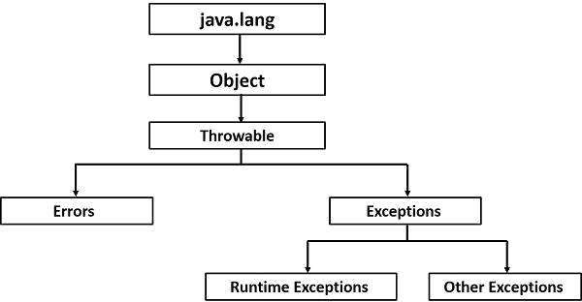
Exception Hierarchy
All exception classes are subtypes of the java.lang.Exception class. The exception class is a subclass of the Throwable class.
Key words used in Exception handling
There are 5 keywords used in java exception
handling.
try
catch
finally
throw
throws
Object Oriented Programming
Dr.D.Sivaganesan PSGiTech / CSE
6

Slide 7
Built in unchecked exceptions
Exception & Description
ArithmeticException Arithmetic error, such as divide-by-zero.
ArrayIndexOutOfBoundsException Array index is out-of-bounds.
ArrayStoreException Assignment to an array element of an incompatible type.
IOException It is thrown when an input-output operation failed or interrupted
InputMismatchException This exception is thrown by an instance of the Scanner class to indicate that a retrieved token does not match the pattern for the expected type,
NegativeArraySizeException Array created with a negative size.
OutOfMemory If the JVM is not able to allocate memory for the newly created objects an exception named OutOfMemoryError is thrown.
NullPointerException Invalid use of a null reference.
NumberFormatException Invalid conversion of a string to a numeric format.
StringIndexOutOfBounds Attempt to index outside the bounds of a string.
Object Oriented Programming
Dr.D.Sivaganesan PSGiTech / CSE
7

Slide 8
Built in checked exceptions
Exception & Description
ClassNotFoundException Class not found.
CloneNotSupportedException Attempt to clone an object that does not implement the Cloneable interface.
IllegalAccessException Access to a class is denied.
InstantiationException Attempt to create an object of an abstract class or interface.
InterruptedException One thread has been interrupted by another thread.
NoSuchFieldException A requested field does not exist.
NoSuchMethodException A requested method does not exist.
FileNotFoundException This Exception is raised when a file is not accessible or does not open.
Object Oriented Programming
Dr.D.SivaganesanN.Arvaindhraj PSGiTech / CSE
8

Slide 9
import java.util.*;
class exexception
{
public static void main(String args[])
{
try
{
int a = 10, b = 0;
int c = a/b; // cannot divide by zero
System.out.println ("Result = " + c);
}
catch(ArithmeticException e)
{
System.out.println("ArithmeticException : ");
System.out.println("Can't divide a number by 0");
}
try {
String a = null; //null value
System.out.println(a.charAt(0));
} catch(NullPointerException e) { System.out.println("NullPointerException..");
}
Object Oriented Programming
Dr.D.Sivaganesan PSGiTech / CSE

Slide 10
try {
String a = "GOOD"; // length is 4
char c = a.charAt(10); // accessing 10th element System.out.println(c);
}
catch(StringIndexOutOfBoundsException e) { System.out.println("StringIndexOutOfBoundsException");
}
try {
// "SIVA" is not a number
int num = Integer.parseInt ("SIVA") ;
System.out.println(num);
} catch(NumberFormatException e) { System.out.println("Number format exception");
}
try{
int a[] = new int[7];
a[10] = 5; // accessing 10th element in an array of size 7
}
catch(ArrayIndexOutOfBoundsException e){ System.out.println ("Array Index is Out Of Bounds");
}
try {
Object a[] = new Double[2]; a[0] = 4;
}
catch (ArrayStoreException e) {
System.out.println("ArrayStoreException found: "+ e);
}
try {
Integer[] array = new Integer[10000 * 10000];
}
catch (OutOfMemoryError e) {
System.out.println("OutOfMemoryError: "+ e);
}
Object Oriented Programming
Dr.D.Sivaganesan PSGiTech / CSE

Slide 11
try
{
System.out.print("Enter the data: ");
Scanner scan=new Scanner(System.in);
int data = scan.nextInt();
}
catch (InputMismatchException ex )
{
System.out.println("InputMismatchException" + ex);
}
try
{
int[] arr=new int[-10];
}
catch (NegativeArraySizeException ex )
{
System.out.println("InputMismatchException" + ex);
} } }
Object Oriented Programming
Dr.D.Sivaganesan PSGiTech / CSE

Slide 12
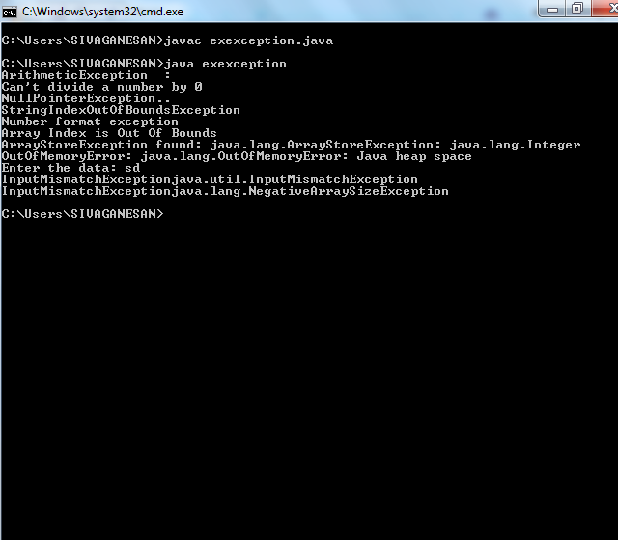
Object Oriented Programming
Dr.D.Sivaganesan PSGiTech / CSE

Slide 13
Catch Multiple Exceptions
Java allows you to catch multiple type exceptions in a single catch block. It was introduced in Java 7helps to optimize code.
You can use vertical bar (|) to separate multiple exceptions in
catch block.
An old, prior to Java 7 approach to handle multiple exceptions.
Syntax :
Catch(Exception1|Exception1|…ExceptionN obj)
{
System.out.println(“Exception”+obj);
}
Object Oriented Programming
Dr.D.Sivaganesan PSGiTech / CSE

Slide 14
public class exmulticatch{
public static void main(String args[]){
try{
int array[] = new int[10]; array[10] = 10/0;
}
catch(ArithmeticException e){
System.out.println(e);
}
catch(ArrayIndexOutOfBoundsException e){
System.out.println(e);
}
catch(Exception e){
System.out.println(e);
} } }
Object Oriented Programming
Dr.D.Sivaganesan PSGiTech / CSE

Slide 15
class exmultiexception{
public static void main(String args[]){ try{
int array[] = new int[10]; array[10] = 30/0;
}
catch(ArithmeticException|ArrayIndexOutOfBoundsException e)
{
System.out.println(e);
}
}
}
Object Oriented Programming
Dr.D.Sivaganesan PSGiTech / CSE

Slide 16
Nested try block try block within a try block is known as nested try block in java. Why use nested try block
Sometimes a situation may arise where a part of a block may cause one errorthe entire block itself may cause another error. In such cases, exception handlers have to be nested.
Syntax:
try
{
statement 1;
statement 2;
try
{
statement 1;
statement 2;
}
catch(Exception e)
{}
}catch(Exception e){}
....
Object Oriented Programming
Dr.D.Sivaganesan PSGiTech / CSE

Slide 17
class nestedtry{
public static void main(String args[]){
try{
try{
System.out.println("going to divide");
int b =39/0;
}catch(ArithmeticException e){System.out.println(e);} try{
int a[]=new int[5]; a[5]=4;
}catch(ArrayIndexOutOfBoundsException e){System.out.println(e);}
System.out.println("other statement");
}catch(Exception e){System.out.println("handeled");}
System.out.println("normal flow..");
} }
Object Oriented Programming
Dr.D.Sivaganesan PSGiTech / CSE

Slide 18
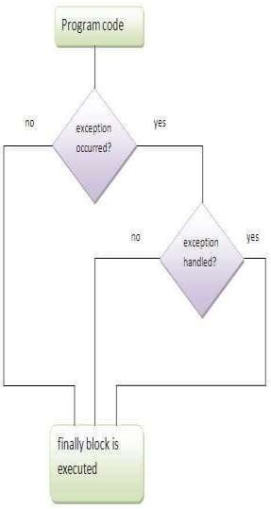
finally block
Java finally block is a block that is used to execute important code such as closing connection, stream etc. Java finally block is always executed whether
exception is handled or not.
Java finally block follows try or catch block.
try
{
statement 1;
statement 2;
}
catch(Exception e)
{
}
finally
{
statement 1;
}
Object Oriented Programming
Dr.D.Sivaganesan PSGiTech / CSE

Slide 19
class exfinally
{
public static void main(String args[]){
try{
int data=25/0;
System.out.println(data);
}
catch(ArithmeticException e)
{
System.out.println(e);
}
finally
{
System.out.println("finally block is always executed");
} System.out.println("rest of the code..."); } }
Object Oriented Programming
Dr.D.SivaganesanN.Arvindhraj PSGiTech / CSE

Slide 20
class finally2
{
public static void main (String[] args)
{ // array of size 4.
int[] arr = new int[4];
try
{ int i = arr[6];
// this statement will never execute
// as exception is raised by above statement
System.out.println("Inside try block");
}
finally
{ System.out.println("finally block executed");
}
// rest program will not execute System.out.println("Outside try-finally clause");
} }
Object Oriented Programming
Dr.D.SivaganesanN.Arvindhraj PSGiTech / CSE

Slide 21

Object Oriented Programming
Dr.D.SivaganesanN.Arvindhraj PSGiTech / CSE

